Slide 1
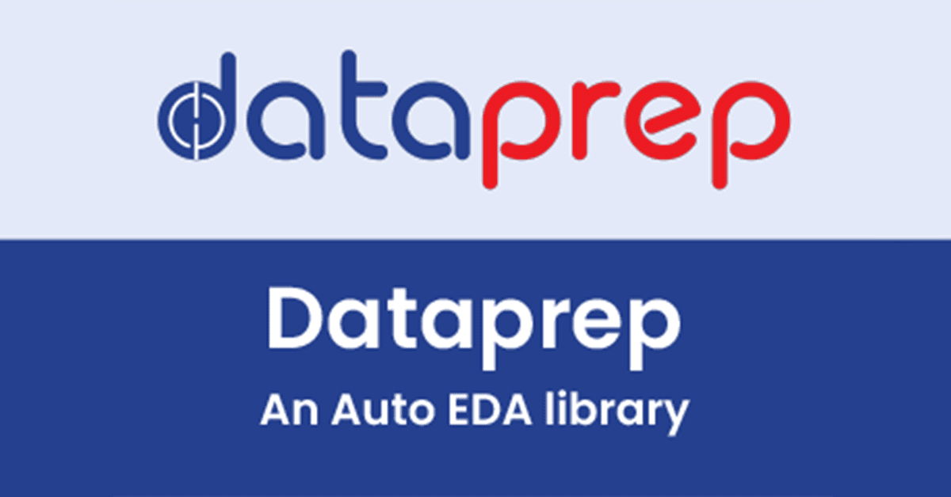
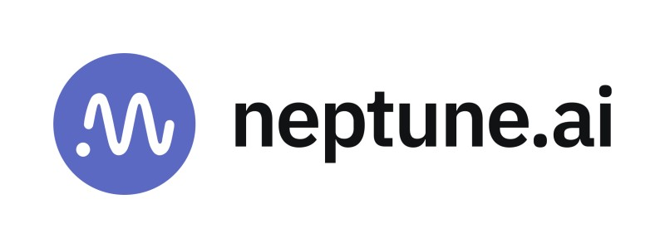
DataPrep & Neptune.ai
Submitted By:
Sanjana Shailesh Bongale (675620038)

Slide 2
Introduction
This project focuses on analyzing the Titanic dataset to uncover insights. I have utilized the DataPrep library for Exploratory Data Analysis and integrated the project with Neptune.ai to explore Experiment Tracking and Management.
Key objectives:
Extract insights from the Titanic dataset using EDA.
Implement experiment tracking for version control and comparison.
Demonstrate the benefits of combining DataPrep and Neptune.ai for streamlined analysis.

Slide 3
Exploratory Data Analysis (EDA) and Experiment Tracking
Exploratory Data Analysis (EDA)
A technique to summarize and visualize datasets.
Helps detect patterns, trends, and anomalies.
Utilizes statistical methods and graphical tools (e.g., histograms, and scatter plots).
Assists in identifying data issues like missing values and outliers.
Aids in formulating hypotheses and making informed decisions.
Experiment Tracking
A systematic approach to monitor machine learning experiments.
Ensures transparency and reproducibility in model development.
Logs important information like model configurations and evaluation metrics.
Facilitates version control for managing datasets and model iterations.
Enhances collaboration and streamlines model comparison for optimization.

Slide 4
Importance of Using MLOps Tools for EDA and Experiment Tracking
Automation: MLOps tools like DataPrep streamline EDA by automating data cleaning, analysis, and visualization, reducing manual effort and saving time.
Version Control: Experiment tracking tools, such as Neptune.ai, ensure proper versioning of data, models, and experiments, enabling teams to track changes and reproduce results easily.
Collaboration: MLOps tools facilitate team collaboration by providing a centralized platform to share results, logs, and visualizations, improving communication and decision-making.
Efficiency: These tools optimize the workflow, allowing data scientists to focus on model development and improving experiment reproducibility with organized tracking and reporting systems.

Slide 5
DataPrep
DataPrep is a Python library specifically designed to simplify data preparation and exploratory data analysis (EDA).
DataPrep streamlines the process of preparing data for analysis by providing intuitive functions that automate common tasks.
Key Features:
Automated EDA Reports: Generate comprehensive reports with a single function call, providing key insights and visualizations.
Visualization Tools: Create charts and plots (e.g., histograms, scatter plots) easily to explore relationships and data distributions.
Data Cleaning: Efficiently handle missing values, duplicates, and improper formats with specialized cleaning functions.
User-Friendly Interface: Intuitive design enables both beginners and experienced users to focus on insights without complex coding.

Slide 6
Neptune.ai
Centralized platform for experiment tracking and model monitoring in machine learning workflows.
Key Features:
Experiment Tracking: Log parameters, hyperparameters, and performance metrics across multiple experiments for easy comparison and debugging.
Visualization & Dashboard: Real-time visualizations of metrics; create custom dashboards for monitoring performance trends and insights.
Model Management: Supports model versioning for easy access and management of multiple model iterations.
Collaboration: Facilitates team collaboration by sharing experiments, results, and visualizations seamlessly.
API & SDK Integration: Offers Python and REST APIs for flexible experiment management and integration into workflows.

Slide 7
Project Methodology

Slide 8
Setting Up Neptune.ai
Step 1.
Neptune.ai Account Sign-up
1
Step 2.
Setting Up a Workspace
2
Step 3.
Creating a New Project
3
Step 4.
API Token Generation
4

Slide 9
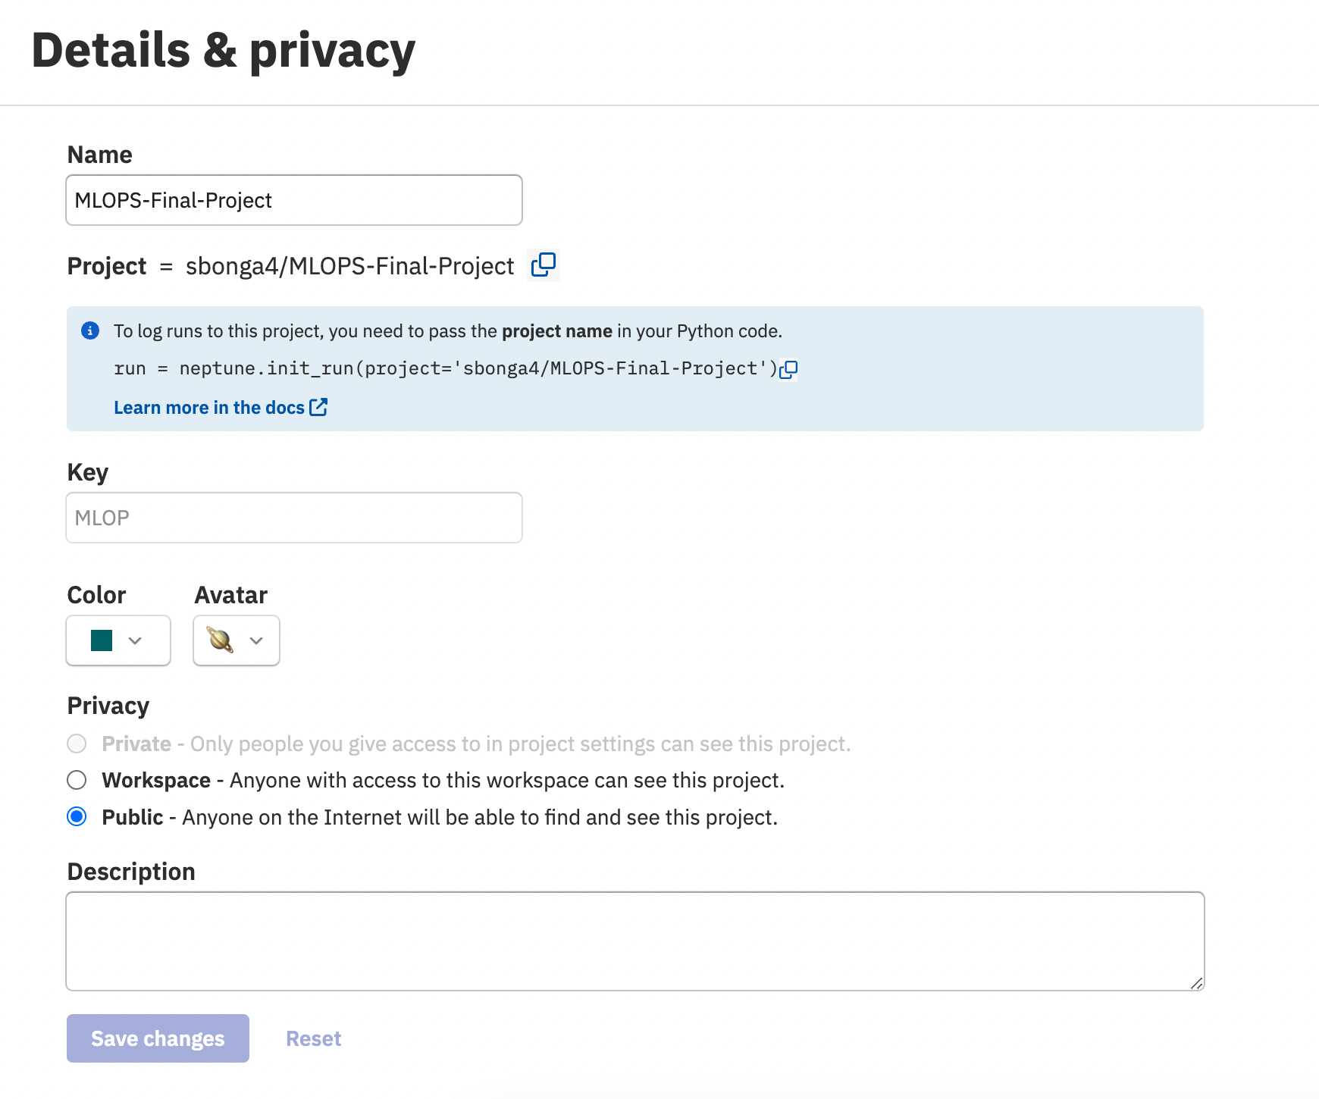
Project Details and Privacy

Slide 10
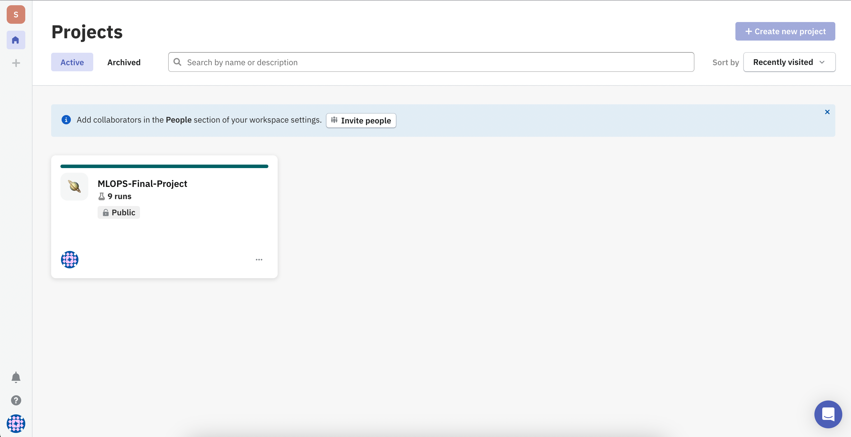

Slide 11

Installation of Required Libraries
The necessary libraries need to be installed in the beginning to facilitate experiment tracking, data exploration, and visualizations.
Command:
Purpose of Libraries:
Neptune.ai: Used for tracking experiments and visualizing results.
DataPrep: Simplifies the exploratory data analysis (EDA) process through automated reporting.
Seaborn & Matplotlib: Libraries for creating customized visualizations.

Slide 12
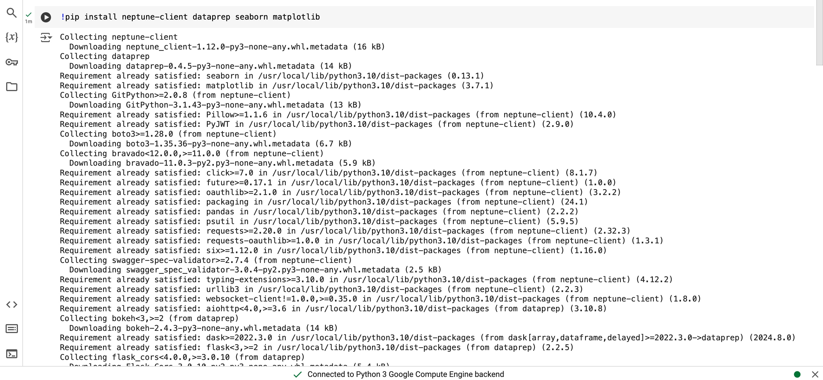

Slide 13
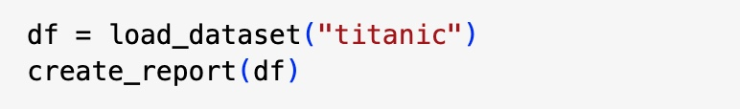
Performing EDA using DataPrep
Loading the Titanic Dataset:
Used the load_dataset() function from DataPrep to import the Titanic dataset easily.
Generating an EDA Report:
Called create_report(df) to produce a comprehensive report.
The report includes key statistics, visualizations, missing values, and data distributions.
Provides a quick way to understand the data at a glance.
Sample Code:

Slide 14
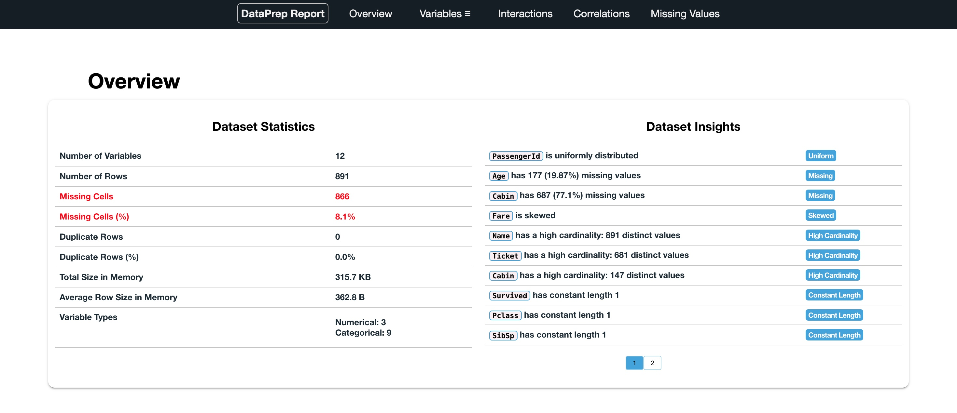

The DataPrep report provides a comprehensive overview of the dataset, including a summary of missing values and variable types. It also delivers in-depth insights for each variable, helping to identify key patterns and relationships within the data.

Slide 15
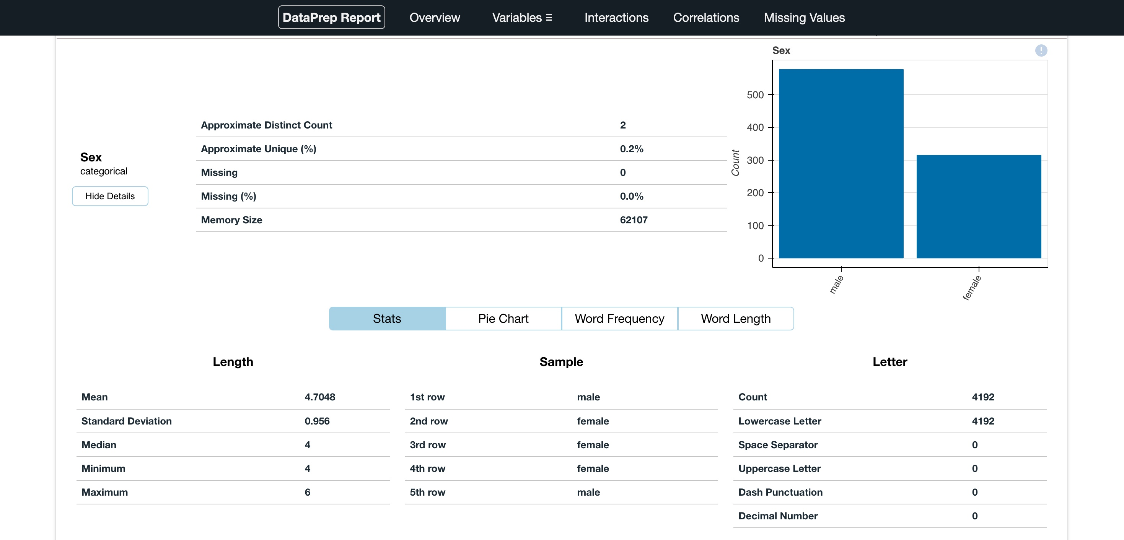
The DataPrep library automatically identifies categorical variables and visualizes them using appropriate graphs, such as pie charts. Additionally, it provides detailed insights specific to each variable, enabling users to understand their characteristics and distributions more effectively.

Slide 16
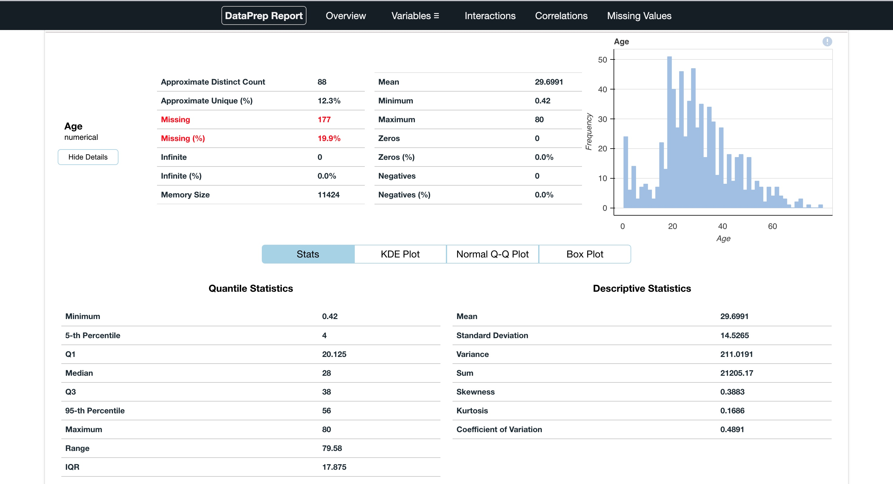
Similarly, it detects numerical variables and visualizes them using suitable graphs, such as histograms and box plots. It also offers in-depth insights into each numerical variable, including statistics like mean, median, and standard deviation. This helps to better understand their characteristics and underlying patterns.

Slide 17
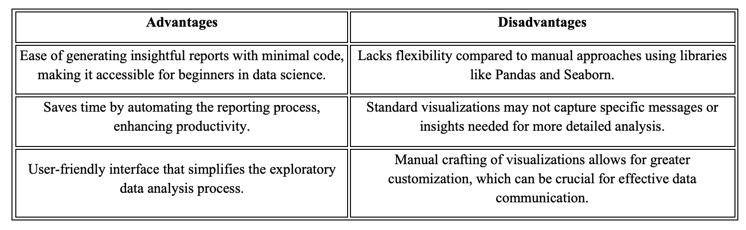
DataPrep Key Learnings
DataPrep streamlines automated Exploratory Data Analysis (EDA) by quickly generating detailed reports and visualizations.
This automation simplifies the process, making it easier for beginners to gain insights without manual data manipulation.
Key advantages and disadvantages of using DataPrep for EDA are summarized below:

Slide 18
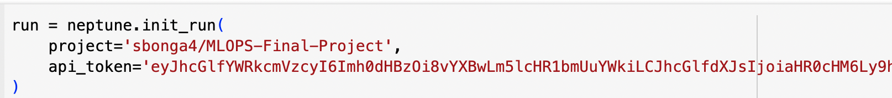

Experiment Tracking and Visualization with Neptune.ai
Performing Experiment Tracking using Neptune.ai
Neptune.ai was integrated into the project to effectively track and manage EDA experiments and visualizations.
To initialize a run, the neptune.init_run() function was used, including the project details and API token. This established a connection between the code and the Neptune platform.
Uploading Visualizations to Neptune.ai
Custom visualizations created with Matplotlib and Seaborn were uploaded to Neptune.ai for future reference.

Slide 19
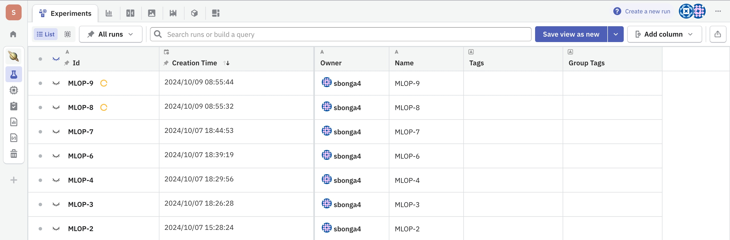
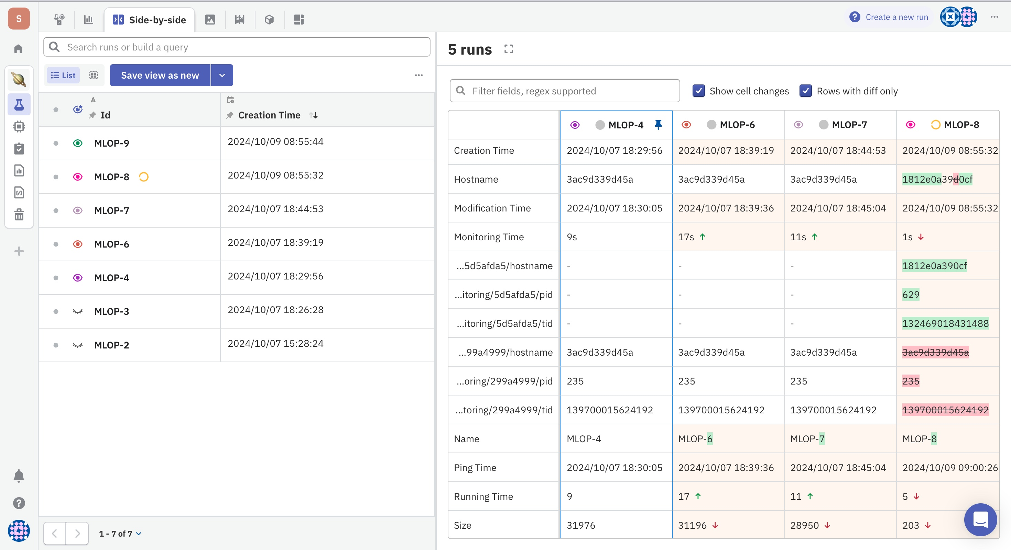
Neptune.ai shows a comprehensive list of all experiment runs, complete with timestamps of when they were created for easy tracking and organization.
It also allows side-by-side comparison of experiment runs, highlighting changes in parameters and metrics for in-depth analysis.

Slide 20
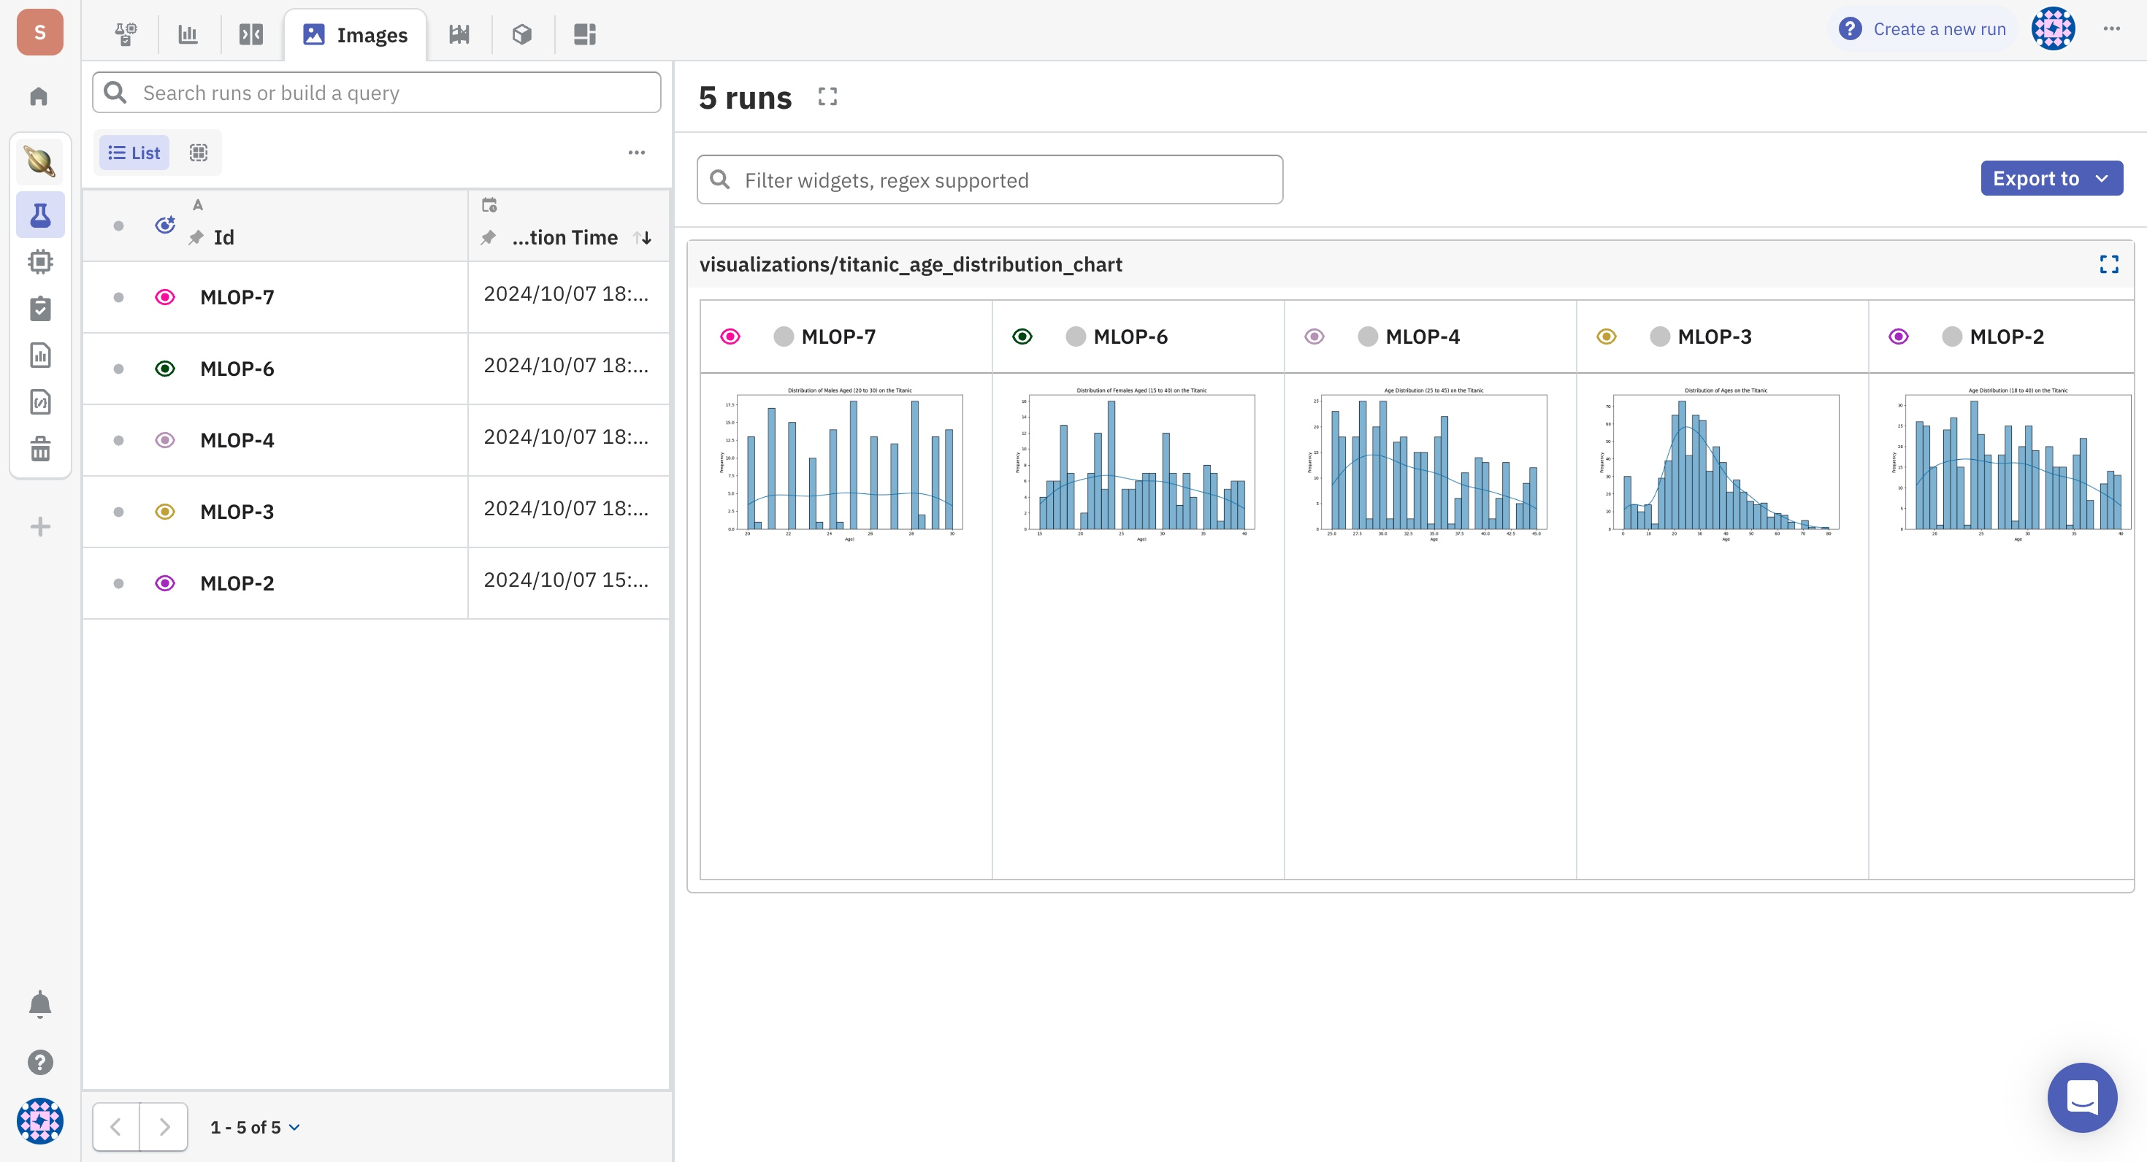
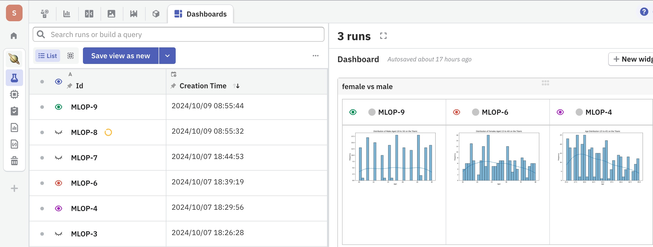
A visual display comparing images generated from each run facilitates easy evaluation of results across experiments.
We can create customized dashboards, enabling the visualization and analysis of data from various runs.

Slide 21
Conclusion
In this project, the use of DataPrep and Neptune.ai for Exploratory Data Analysis (EDA) and experiment tracking provided invaluable hands-on experience with MLOps tools.
Key Takeaways:
DataPrep: Automation makes EDA efficient and approachable for beginners, saving time and reducing complexity.
Neptune.ai: Excellent for tracking, reproducibility, and promoting collaboration in machine learning workflows.
Final Thoughts:
Both tools serve as excellent starting points for newcomers in MLOps, simplifying workflows and establishing a foundation for advanced machine learning practices.
Leveraging these tools will enhance productivity and effectiveness in managing future data science projects.

Slide 22
Thank you!

